Slide 1

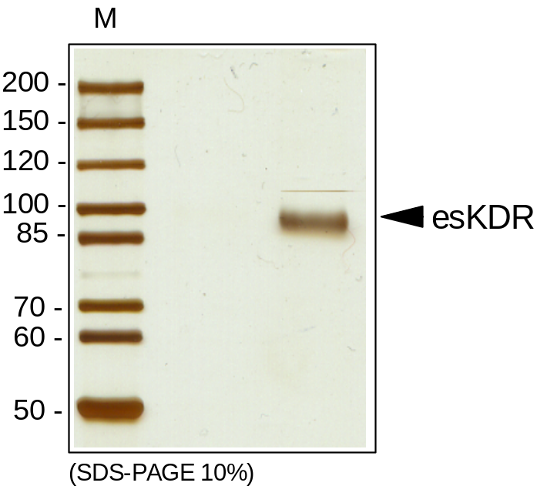
ReliaTech GmbH
Recombinant human endogenous soluble VEGFR-2/sKDR (esKDR)
(Cat # S01-003 / S01-004)
Fig. 1: SDS-PAGE analysis of recombinant human endogenous soluble VEGFR-2/KDR (esKDR) produced in insect cells. Sample was loaded in 10% SDS-polyacrylamide gel under reducing conditions and stained with Silver stain.
http://www.reliatech.de / orders@reliatech.de

